Slide 1
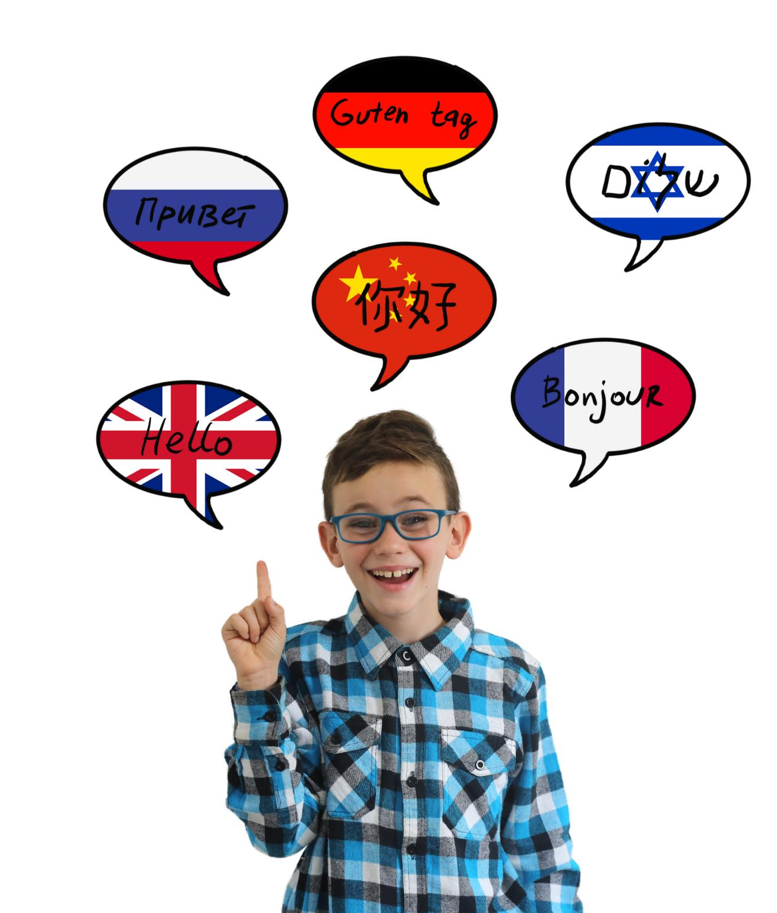
Dough, Cough, Rough: How English Got Weird
The History and Evolution of the English Language
Notes:
I was inspired to give this talk after listening to Andrew Reekes talk so passionately about the history of Wixford and I thought what else do the residents of Wixford have in common aside from a love of local history? The language we speak!
I chose the title deliberately – 3 words spelt almost the same except for the initial letter but pronounced completely differently. We learn these words in school and have probably never questioned why it is that they’re pronounced differently. The reasons for this will become clear later.
So, I am going to take you on a journey through the history and development of the English language, from its prehistoric origins to the present day. We will explore the various influences that have shaped the language and the key moments that have transformed it into the global language it is today.

Slide 2
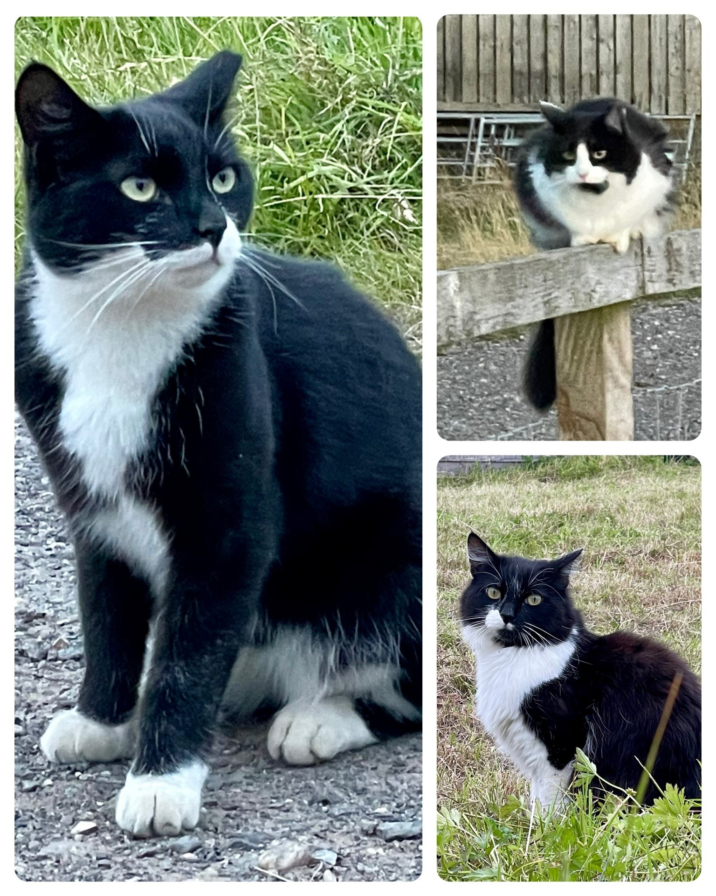
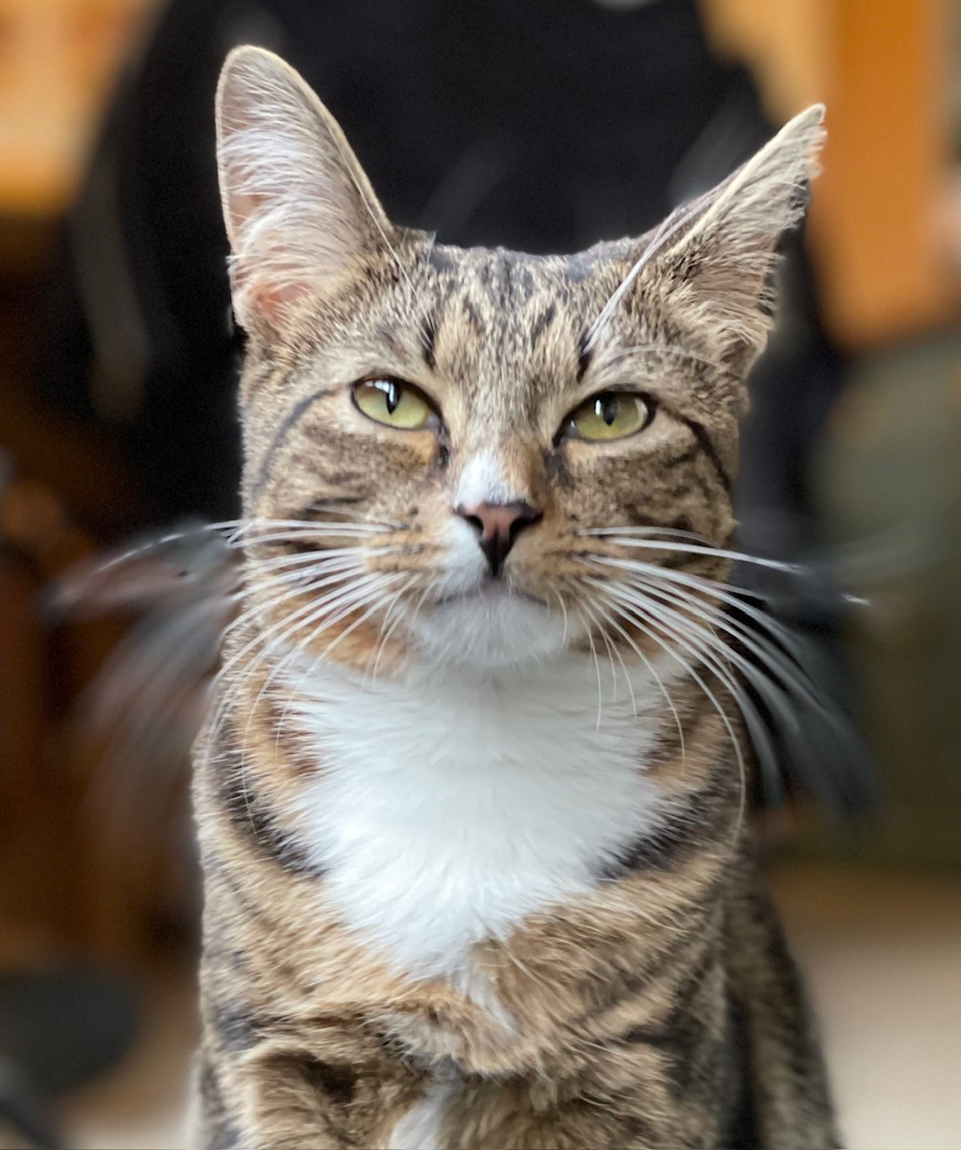
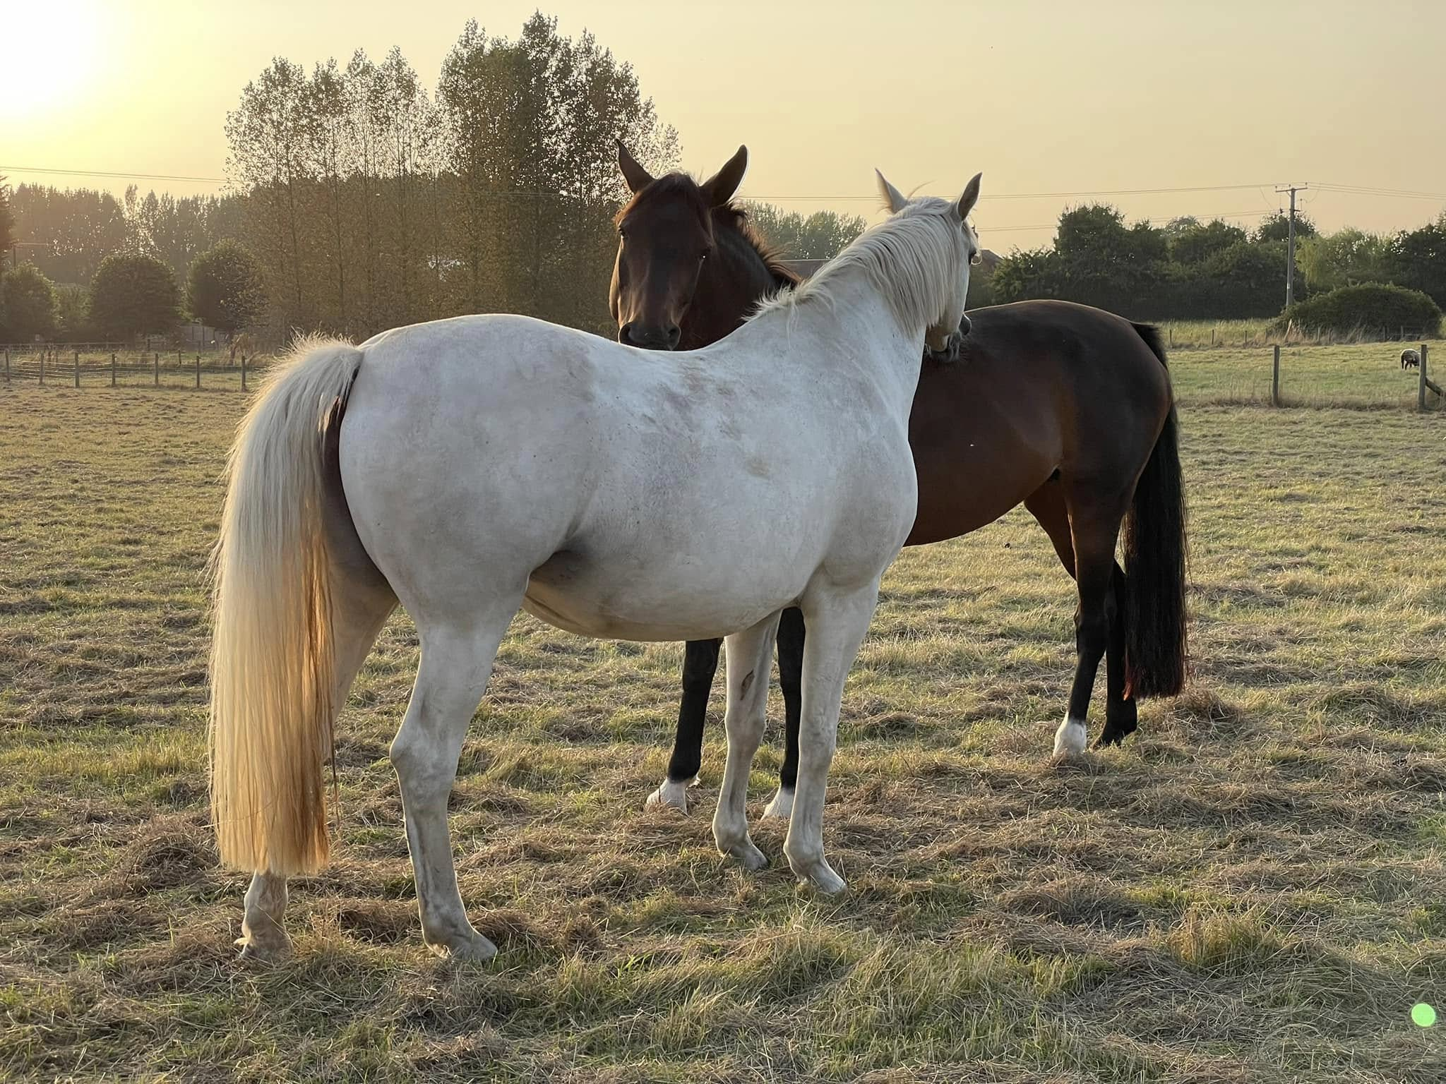
About Me
Moved to Wixford in June 2022
Married to Claire for 24 years
Lots of pets
Stockholm, 2019
The Boys
Bear
Rosie & Tarro
Poppy
Lola
Notes:
A little bit of information about me
Lived in Wixford for 2.5 years
Married to Claire and we have 2 horses, 2 dogs, 3 feral cats, and 1 house cat
One of my other hobbies is karate
Disclaimer – I am not a language expert – far from it

Slide 3
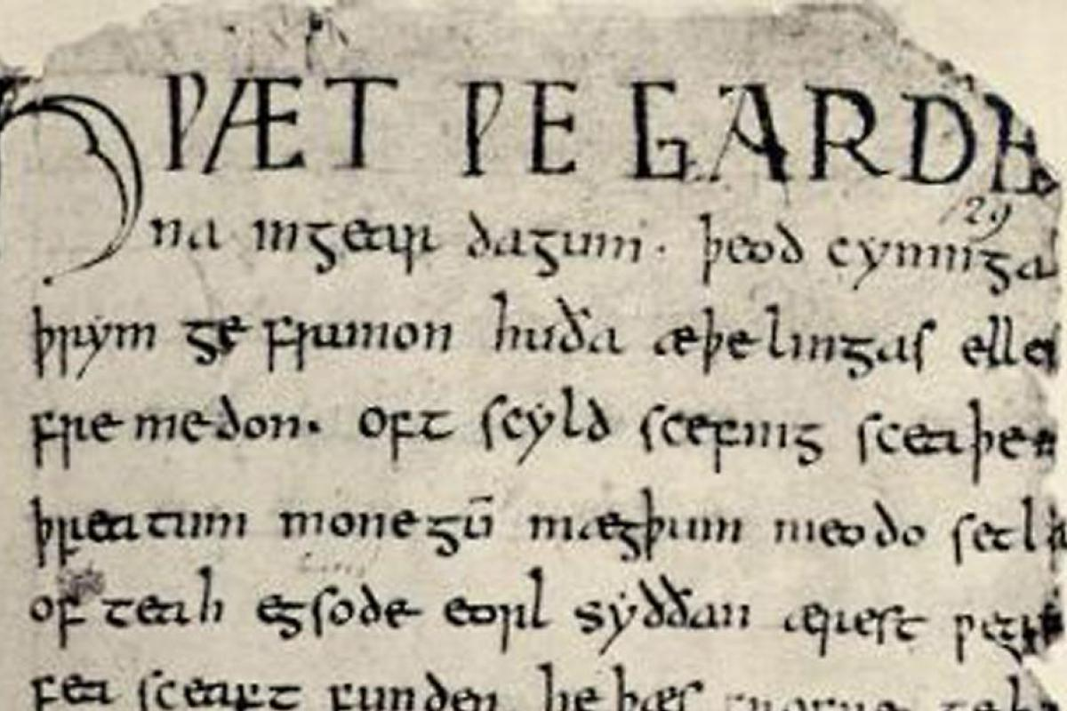
Agenda
Overview
Anglo-Saxons & Vikings – Old English
Norman Conquest – Middle English
Shakespeare and Beyond – Modern English
Present Day
Notes:
Tonight’s talk is divided into 5 parts
Firstly, a general overview of the English language. Then we get into the historical part.
The history of English is divided into 3 parts called Old English, which starts with the Anglo-Saxons, then the influence of the Normans which gave us Middle English and then a look at Warwickshire’s most famous son, William Shakespeare and the start of the Modern English period.
It might surprise you to learn that Shakespeare wrote in Modern English if, like me, you struggled to understand Shakespeare at school. The reasons why people find Shakespeare difficult is not down to vocabulary and grammar but for other reasons which become apparent later.
And then to finish, we’ll look at some of the factors shaping present-day English and perhaps speculate on how things might develop in future.
I hope to cover the first three parts before we take a break for refreshments and then cover the other two parts in the second half.

Slide 4
Overview of English
Spoken by 1.5 billion people
Estimated to have 170,000 words (and a further 47,000 obsolete words)
Language of international air travel, merchant shipping and finance
Average adult knows 25,000-30,000 words
Can be fluent with as little as 3,000 words
Adaptable and rich language but can be confusing!
Notes:
Not the most popular native language (Mandarin Chinese) but by far the most popular language amongst people who speak English as a 2nd/3rd language – roughly 20% of the world’s population.

Slide 5
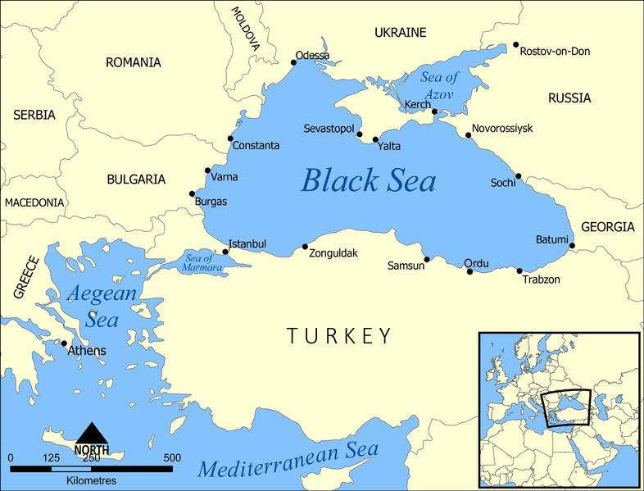
Prehistoric Origins: The Proto-Indo-Europeans
4500BC-2500BC
Semi-Nomadic herders, domesticated cattle, dogs and horses
Wheeled wagons
Most European & Indian languages are descended from this common ancestor
1,300-2,000 reconstructed words
Notes:
Eurasian Steppes – large areas of open grassland (like prairies in America)
As they grew & expanded, they spread out and settled in different areas

Slide 6
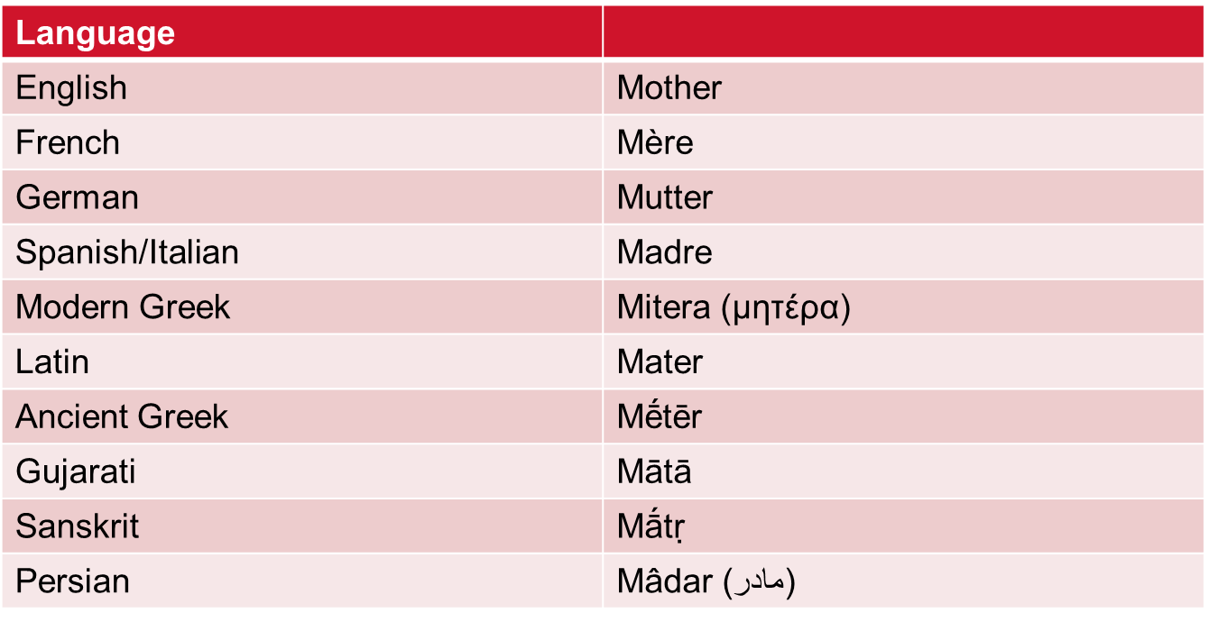
How to Reconstruct a Dead Language
Proto-Indo-European Méhtēr
Notes:
Eurasian Steppes – large areas of open grassland (like prairies in America)
As they grew & expanded, they spread out and settled in different areas

Slide 7
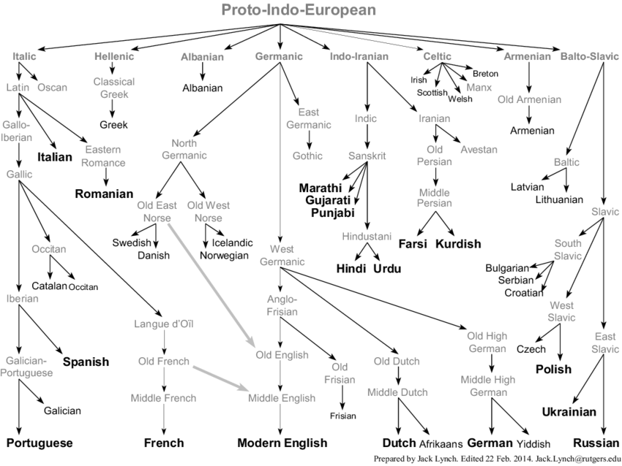
Notes:
Linguists have good evidence to suggest that almost all the languages of Europe and those of the Indian sub-continent, are all descended from one language that was spoken about 6000 years ago.
These are not the only languages descended from proto-indo-European – over 400 but the majority no longer exist

Slide 8
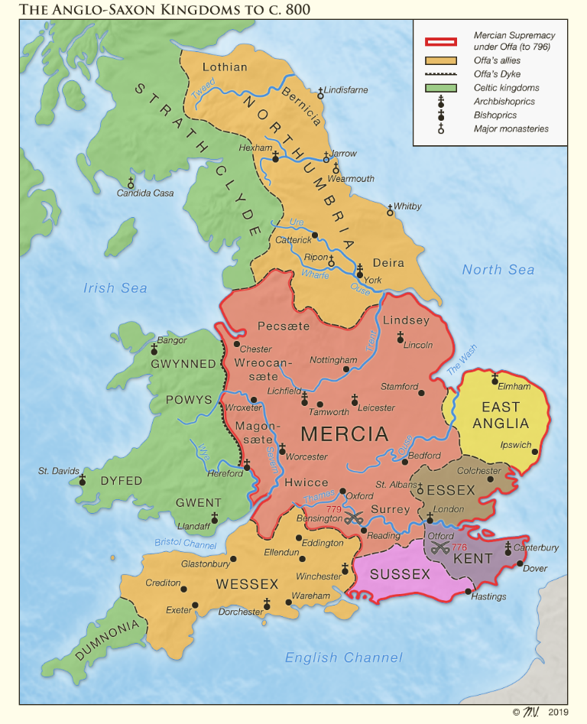
Old English: The Anglo-Saxons
Before the arrival of the Anglo-Saxons, most of Western Europe was inhabited by Celtic-speaking tribes, including the Britons
Anglo-Saxons arrived in 450AD and brought their Germanic language with them
Established several regional kingdoms – Essex, Wessex, Sussex and Mercia pushing the Celts north and westwards
Celtic languages have survived in Wales, Ireland, Scotland, Cornwall, Isle of Man (Manx) and northern France (Breton)
Notes:
The Anglo-Saxon era marks the first significant period in the development of the English language, with Old English being the earliest form of the language.
Britons arrived during the Iron Age (1000BC) and survived the Roman invasions. The Romans didn’t leave much a mark on our language – Latin came later. Left us with roads and place names, including our own Alcester.
Anglo Saxons made of not 2 but 3 groups – Angles, Saxons from northern Germany, and the Jutes from Denmark - Jutland
We get the name of our country England from the Angles – literally Angle-land.
Our language comes from the Saxon dialect – and in fact, the Scottish word Sassenach (and Saesneg in Welsh) meaning an English person translates as “Saxon-person”
When I talk about the Saxons bringing us their Germanic language, I’m not talking about modern German. Rather, Old English and German are both descended from an earlier language.
The Anglo Saxons pushed the Celts to the fringes, those Britons who weren’t subjugated into Anglo Saxon society, some of those made their way to northern France (Brittany / Breton)

Slide 9
Characteristics of Old English
No definite or indefinite articles (the/a/an)
Three noun genders (m, f, n) and 5 cases
Only 2 verb tenses – past and combined present/future
90% of the 200 most common words in English are of Germanic origin
Family relationships
Body parts
Plants & animals
Common verbs (be / go / have / make)
Example: “hund” (dog)
Nominative: hund (s) hundas (pl)
Accusative: hund (s) hundas (pl)
Genitive: hundes (s) hunda (pl)
Dative/Instr: hunde (s) hundum (pl)
Notes:
Old English was much more complicated compared to modern English
Our commonest words
- Family relationships
- Body parts
- Plants & animals
- Common verbs like to be / go / have

Slide 10
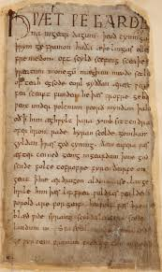
Earliest Example of Old English
Beowulf – an epic poem dating from 8th century but based on events in 6th century Scandinavia
Hwæt! We Gar-Dena in gear-dagum,
þeod-cyninga þrym gefrunon,
hu ða æþelingas ellen fremedon.
Listen! We the Spear-Danes in days of yore,
Of the clan-kings, glory-heard,
How those princes valour performed.
Listen! We have heard of the might of the kings of the Spear-Danes in days gone by, and how those princes performed great deeds of valour.
Notes:
Only surviving manuscript dating from the 10th century is on display in the British Library
https://www.youtube.com/watch?v=CH-_GwoO4xI

Slide 11
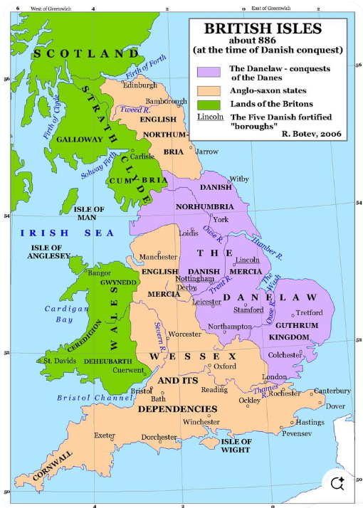
The Vikings (Danes)
Raided England several times in 8th century
Spoke Old Norse (North Germanic)
Left us about 700-900 words and other grammatical changes, e.g. pronouns
Days of the week
Bairn, berserk, sky, club, ransack, scathe, husband (“house holder”),
Place names: -by, -kirk, -thorpe, -dale, -holm
Surnames: -son, -sen
Culture/folklore

Slide 12
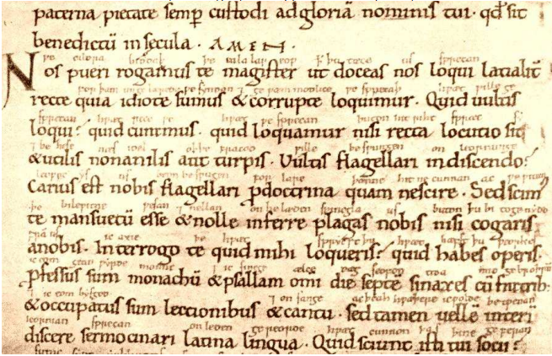
Ælfric’s Colloquy (990AD)
Teaching aid based on conversations about everyday occupations:
[Teacher:] Is þæs of þinum geferum?
[Pupil A:] Gea, he is.
[Teacher:] Canst þu ænig þing?
[Pupil E:] Ænne cræft ic cann.
[Teacher:] Hwelcne cræft canst þu?
[Pupil E:] Ic eom hunta.
[Teacher:] Hwæs hunta eart þu?
[Pupil E:] Ic eom þaes cyninges hunta.
Notes:
Approx 200 years after Beowulf was written, we can see another example of Old English.
Aelfric was an abbot (head of a monastery) and wrote this manuscript as a way of teaching Latin to novice monks. One of the student monks has written an Old English translation of the Latin in between the lines.
https://www.youtube.com/watch?v=NBKzZhPev24
http://www.vikingage.org/wiki/wiki/Aelfric%E2%80%99s_Colloquy

Slide 13
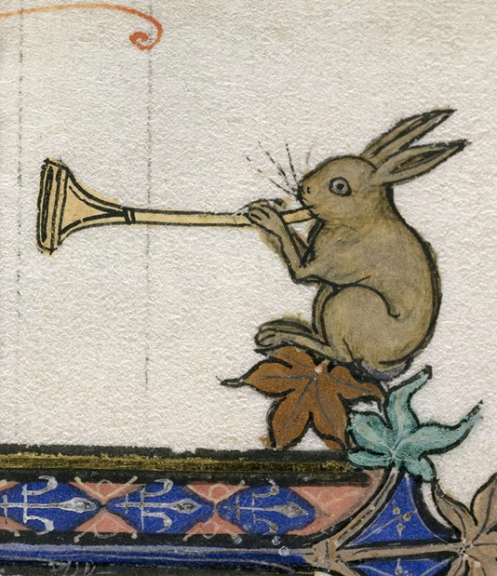
The Norman Conquest and Middle English (1066-1450)
30,000 new words of French (and indirectly, Latin) origin were absorbed into English
English was still the common language, but French was the language of the courts, government and nobility
Law, politics & military
Judge, jury, evidence, justice, court
Minister, cabinet, government, parliament, military, army
Food and meat - beef, pork, veal, mutton and venison
Prefixes and suffixes
re-, con-, dis-, pre-, pro-, en-, trans-
-ant, -ance, -ation, -ment, -ism, -able, -al, -ous
Combinations of French and English e.g. re + born = reborn
Only changed when England defeated France in the 100 years war in 1453
English had lost most of its Germanic complexity including noun gender
Notes:
After defeat of King Harold in 1066 and over next 300 years, French words and grammatical constructs were gradually absorbed into English. This is the first of two events that had a lasting impact on the English language.
French disappeared as the language of government when England defeated France in the 100 Years War (1337-1453). Henry IV (1399-1413) took oath in English; Henry V wrote in English.
By the end of French rule, English had lost much of its Germanic complexity and was much simplified (noun gender disappeared)
French has continued to influence English with many idioms such as je ne sais quoi and joie de vivre used unchanged.

Slide 14
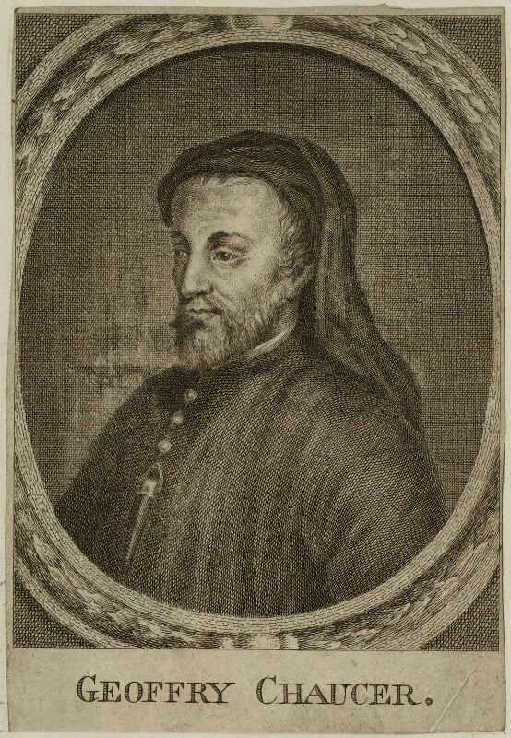
Geoffrey Chaucer (1342-1400)
The Canterbury Tales – a collection of stories about a group of pilgrims on a journey to Canterbury Cathedral
Whan that Aprill with his shoures sote The droghte of Marche hath perced to the rote, And bathed every veyne in swich licour Of which vertu engendred is the flour;
When April with his sweet-smelling showers Has pierced the drought of March to the root, And bathed every vein in such liquor By which power the flower is engendered;
Spelling and structure closer to modern English, but pronounced differently e.g. Knight = “k-nick-t”
Anglo Saxon letters disappeared from the alphabet
Notes:
Notice the swap hw > wh, and the disappearance of the Anglo-Saxon letters
5 regional dialects, Chaucer wrote with a London dialect, but used dialects in his writing

Slide 15
Tea-Break Teaser
There are some European languages that are not descended from Proto-Indo-European.
Can you guess what they are?
Turkish
Finnish
Estonian
Hungarian
Basque
Maltese

Slide 16
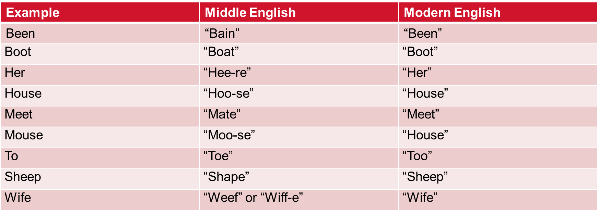
Early Modern English (1450-1750)
Less than 100 years after Chaucer’s death, 3 more things happened that had a significant impact on the development of English:
Advent of the printing press (William Caxton, 1476)
The Renaissance (“rebirth”) – great explosion in art, science, medicine and exploration
The Great Vowel Shift – series of gradual sound changes over time
Notes:
Less than 100 years after Chaucer’s death 2 things happened that greatly changed English
The printing press, the dawn of the age of mass media
- literacy (compulsory education only dates from 1870)
- London dialect dominant
The Great Vowel Shift – linguistic changes that happened slowly over 250-300 years, not sure why but population migrations caused by the Black Death may have been a contributory factor (clashes of accents and dialects). The end result being that many words changed how they sounded but, crucially, kept their original spellings – and the shift wasn’t consistent, not all words changed the same way, especially words with short vowels (dog, cat, mud).
Chaucer and Shakespeare often cited as examples as they lived around the time of the start and end of the GVS. In Chaucer’s time words like food, good and blood would have been pronounced in a way to rhyme with “goad” or “toad”. In Shakespeare’s time, they would still rhyme, but this time they would all sound like the “oo” in food. Food, good, and blood. Clearly, good and blood have changed further.
Other things that happened during this time:
- the Renaissance (rebirth) – great explosion in art, science and medicine inspired by ancient Greeks and Romans
- almost all the scientific terms we use are of Greek or Latin origin
- maritime exploration and international trade with expeditions to India and the Far East
Christopher Columbus, Vasco da Gama, and Ferdinand Magellan

Slide 17
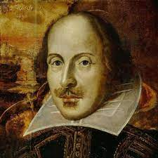
William Shakespeare (1564-1616)
Our most prolific playwright, credited with adding 1,700 words to English, including many idioms that are in daily use today.
Break the ice - The Taming of the Shrew
Heart of gold - Henry V
Wild-goose chase - Romeo and Juliet
In a pickle - The Tempest
Winter of discontent – Richard III
Green-eyed monster - Othello
Wear one's heart on one's sleeve - Othello
Bated breath - The Merchant of Venice
Fair play - The Tempest
All's well that ends well - the play of the same name
Love is blind - The Merchant of Venice
Fool's paradise - Romeo and Juliet
To thine own self be true - Hamlet
In one fell swoop - Macbeth
Dead as a doornail - Henry VI, Part 2
Notes:
39 plays, 154 sonnets, and two long poems, widely studied not just in the UK but abroad. Credited with inventing about 1,700 words. These words probably already existed in English at the time, but Shakespeare’s writing is the first time they appeared in print.
There are other writers whose work is synonymous with the culture e.g. Joyce (Ireland), Burns (Scotland), Dylan Thomas (Welsh) but nowhere near as prolific.
Idioms are one of the things that makes English especially difficult for foreign learners because they have no equivalent
Studying Shakespeare is difficult even for native speakers because words had slightly different meanings to what they do now e.g. fair and like some of the earlier examples, there’s lots of metaphorical language used.
I am in blood, stepped in so far that, should I wade no more, returning were as tedious to go o’er - Macbeth
He jests at scars that never felt a wound (Romeo)
https://www.youtube.com/watch?v=t_X1dbO-quI

Slide 18
What Makes Shakespeare Difficult?
There are a few reasons why even native speakers of English find Shakespeare difficult:
Archaic and unfamiliar vocabulary – some words have changed in meaning since
Often writing in verse, not prose, so word order doesn’t follow natural speech
Historical context - references to contemporary political, social and cultural events
Greek and Roman mythology
Subtle and layered meanings within the storyline
Metaphorical imagery
Romeo – “He jests at scars that never felt a wound”
Macbeth – “I am in blood, stepped in so deep that should I wade no more, returning is as tedious to go o’er”
Notes:
Shakespeare wrote in a form called iambic pentameter – groups of 5 syllables

Slide 19
Late Modern English (1750 onwards)
Vocabulary expansion and semantic changes
Samuel Johnson’s dictionary (1755)
Standardisation of spelling and grammar
Simplification
Thee, thou, thy, thine > you, your and yours
Verb endings
Notes:
Expansion due to loanwords from Latin, Greek and French. Colonisation.
Meaning of words evolving/changing e.g. “gay” meant happy, “nice” – ignorant, wanton
Spelling of words was standardised in 1755 when Johnson’s English dictionary was published, contained 40,000 words and was only surpassed when the OED was published in the late 19th century.
Could English be simplified even further?
E.g. “Three boats sank yesterday” could become “Three boat sink yesterday” – does it sound unusual? That’s exactly how you would say it in Mandarin Chinese. They have no plural forms for nouns. Similarly, verbs have no past or future tense – the time indicates when the activity took place.

Slide 20
Present Day
The English language continues to expand every year. Factors include:
Globalisation
Migration & multiculturalism
Science & technology
Film & music
Youth culture & slang
Innit, rizz, slay, bro, bruh, lol
Emojis and text-speak (how r u?)
Notes:
Something like 1,000 new words per year are added to English.
English has become a sort of global lingua franca (common language) and incorporates words from around the world, even words like Schadenfreude.
Words from former colonies like India, the Caribbean, Africa and the Far East
Technology, particularly the Internet and social media (how r u?) lol
American culture
Words like innit, bro, bruh

Slide 21
How would English look without the “foreign” bits?
There is a growing web-dwelling fellowship of folk who choose to speak our tongue without any words that came from lands beyond our own.
This wordcraft is called Anglish.
In this speech, words like 'television' would be named far-seer, and 'telephone' would be called far-sounder, or perhaps far-hearer.
It is a far more hard-won work than one might first think - there has been such a great inflood of bits into our word-ken over the hundred-years that it is near-on unthinklike to see how our speech would have grown otherwise.

Slide 22
So, How did English Get Weird?
Not one language but a mashup of Germanic (26%), French (29%), Latin (29%), Greek (6%) and other languages (10%)
The Great Vowel Shift left us with many inconsistencies between the way words are spelt and pronounced
We have many linguistic hangovers from our Germanic roots
House > houses - neuter (hus > hus)
Mouse > mice - feminine (mus > mys)
Goose > geese - feminine (gos > ges)
It is so good at incorporating words from other languages because it is a process that has been going on for 1,500 years!
Notes:
Why is English weird?
It is a mongrel language, made up of Germanic, French, Latin and other influences – this is why English is so great at absorbing words from other languages – it is a process that’s been going on for 1,500 years

